Slide 1
Fashion-mnist dataset
Haja Amir Rahman
DAAAFT2B06
P2100803

Slide 2
TABLE OF CONTENTS
01.
02.
03.
data exploration
simple baseline model
own model
04.
05.
06.
data augmentation
Model Improvement
conclusion
Notes:
In this presentation I’m going to cover the main structure that I used to do this section of the assignment. First I’ll be explaining the data exploration aka EDA followed by the architecture and results of the this simple basline model, Then I’ll explain the architecture and evaluation of my own model then what type of data augmentation I performed for model improvement. Finally I’ll explain the model improvement process, in this case being hyper parameter tuning using keras tuner hyperband and lastly the conclusion with regards to the final verdict of the highest score achieved.

Slide 3
01.
Exploratory data analysis (EDA)

Slide 4
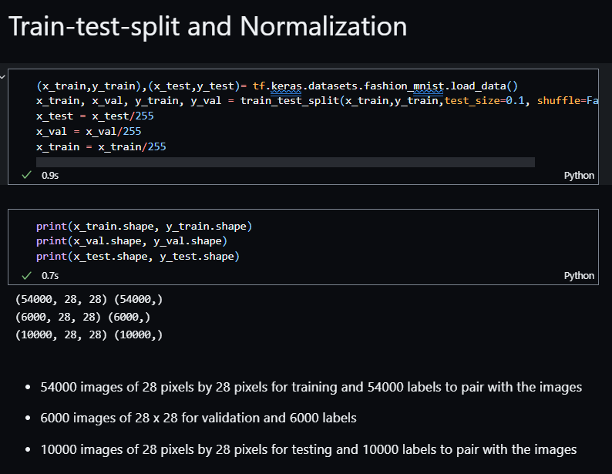
EDA
Class names
Tshirt/top, Trouser, Pullover, Dress, Coat, Sandal, Shirt, Sneaker, Bag, Ankle Boot
Train-test-VAL-split & normalization
X_train, y_train, x_val, y_val and x_test, y_test
Notes:
For EDA, I extracted the class names from the dataset information site (which I have included in the references). I then proceeded with the train test split after loading the data. Then I normalized the data by transforming the already split train test and validation data such that all of them are on a similar scale. This was useful since features in this dataset which are images are on different scales.

Slide 5
02.
Simple baseline model

Slide 6
process
Architecture
Building
evaluation
Used a simple architecture of 1 Conv2D layer, 1 Flatten and 2 Dense layers
X_train, y_train, validation_data(x_val, y_val)
After fitting the model, I used model checkpoints as callback in the fitting process to get the best weight and evaluate
Notes:
For the simple baseline model, I created a simple architecture of one 2d convolutional layer, 1 flatten layer and 2 Dense layers. For the building, I fit the model with the x train and y train data and included the validation data as well so that I could calculate the training and the validation accuracy. After fitting the model, I used model.checkpoints to load the best weights for evaluation

Slide 7
Model evaluation
Used tf.keras.callbacks.ModelCheckpoint() function to monitor for the best validation accuracy and loss produced while fitting the model
Used the same method to save the model with the best weight using the h5 extension.
Thanks to the callback and checkpoint method, I could use the load_weights function to import the best validation accuracy and loss checkpoints for model evaluation on the test data. This method allowed for the most accurate accuracy and loss values for analysis.
I employed this same method for the rest of the models compiled and fitted for this section of the assignment
Notes:
This slide is basically my explanation for using the model checkpoints function to achieve efficiency and accuracy in running my models and evaluating them to get the best results possible. This is a very useful methods especially if I do not wish to re-run the models all over again and just wish to load the already saved best weights or best model itself to prove evaluation results.

Slide 8
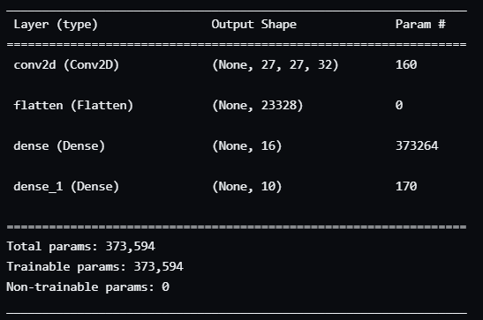
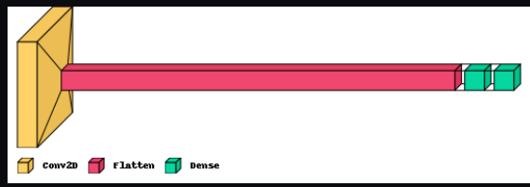
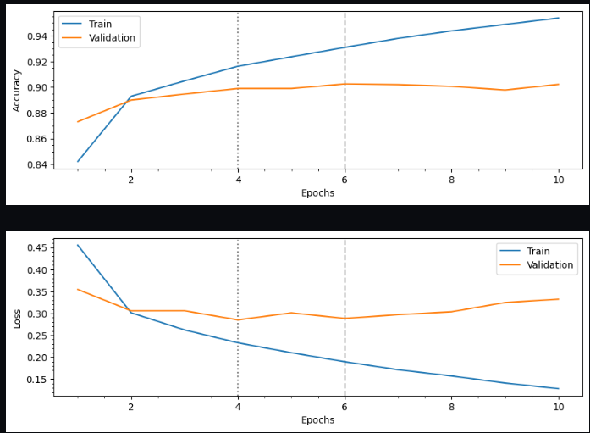
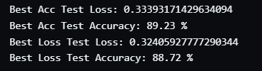
Baseline model architecture and evaluation
Notes:
This is a visualization of the architecture that I mentioned earlier and the best training and validation accuracy for the model in value and graph for convenient comparison

Slide 9
03.
Own model

Slide 10
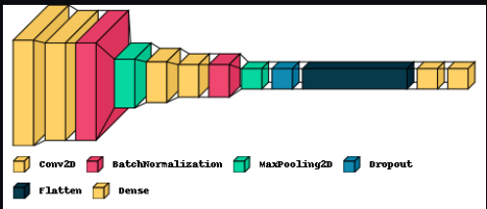
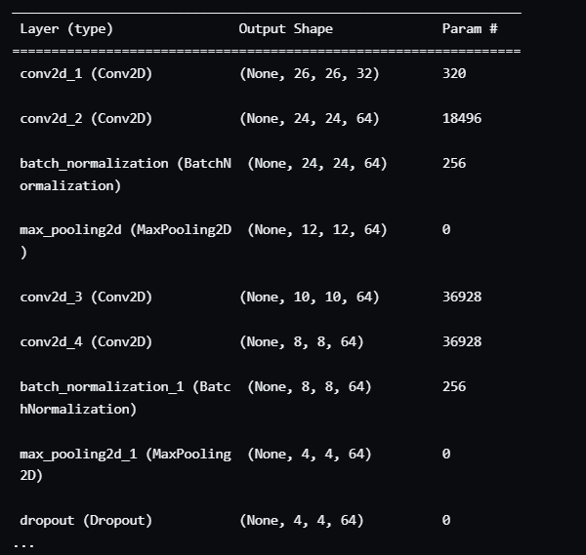
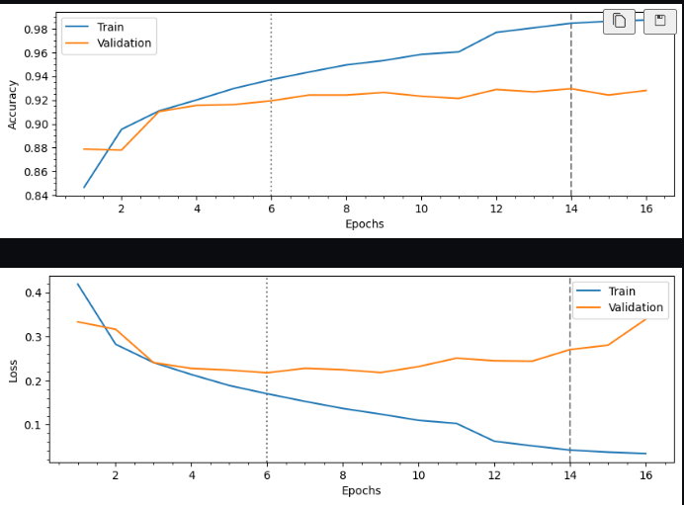
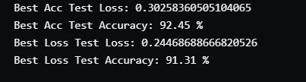
Own model architecure and evaluation
Notes:
Now for my own model that performed a lot better, I have a clear visualization of the architecture for your reference. The test accuracy is at 92.45% for this model

Slide 11
04.
Data augmentation

Slide 12
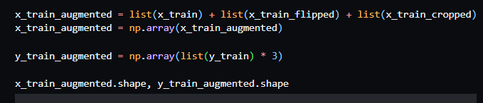
augmentation
Flipped images
x_train_flipped
Cropped images
x_train_cropped
Added all training data using numpy array
Since x_train data has been tripled, I tripled the y_train data as well otherwise it would not make sense when I build and run the models
Notes:
For data augmentation, I flipped and cropped all the images and added them together into an augmented variable for training. Since the x train variable as essentially be multiplied by 3 we need to do the same for y train variable so that we have enough target data to train on

Slide 13
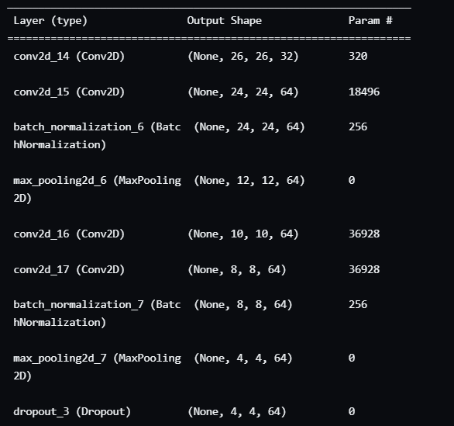

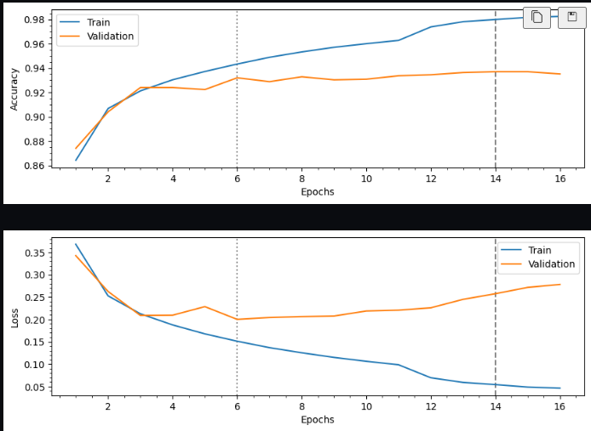
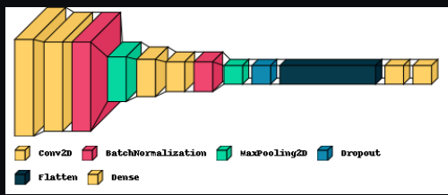
Own augmented model architecture AND EVALUATION
Own Model Augmented Test Accuracy and Loss
Notes:
These are the architecture and evaluation results of my own augmented model. The test accuracy is at 93.25% and the loss is at 0.28

Slide 14
05.
Model improvement

Slide 15
Tensore core keras tuner
visuals
Keras Hyperband
Early stopping callback
Early stopping is used to monitor for max validation accuracy with a patience of 5 as the number of epochs to run is 50
Number of units in first densely connected layer and optimal learning rate
Graphs plotted to show the difference in performance between the hyper model fit with and without augmented data
Notes:
For model improvement I applied keras hyperband method which decided the best number of units in the first densely connected layer and the optimal learning rate. I used early stopping to monitor for max validation accuracy while the model is running with a patience of 5 so that though I set the model to run at 50 epochs it will auto stop once the learning rate is at constant or the max validation accuracy is at a constant for both than 5 epochs

Slide 16
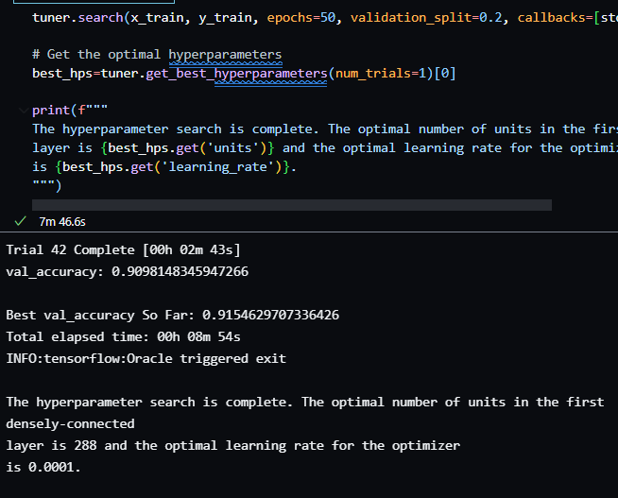
Hyperparameters
Optimal number of neurons in first densely-connected layer: 288
Optimal Learning Rate for Optimizer is 0.0001
Best Validation Accuracy so far: 0.915 (3 d.p.)

Slide 17
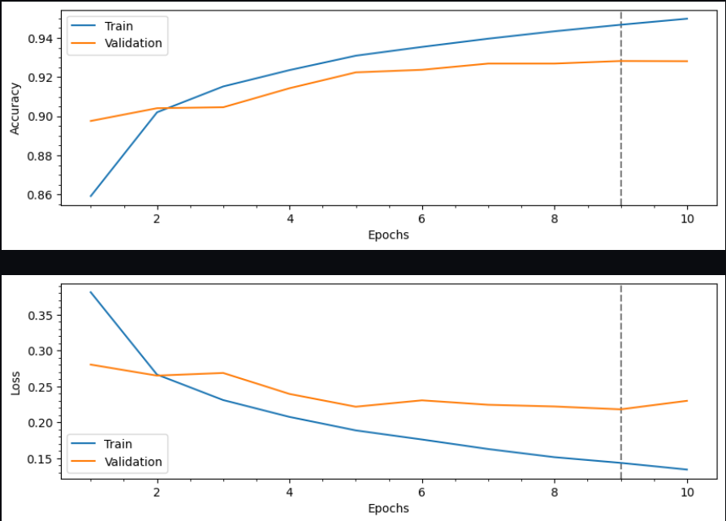
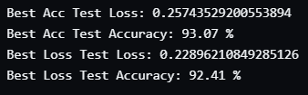
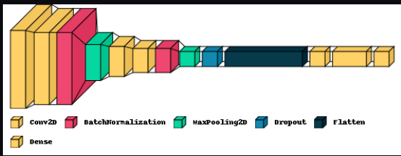
Graph for Hyper model with augmentation
Notes:
Here are the details for the hyper tuned model fit with augmented data for both training and validation. It achieved a test accuracy of 93.07% which is slightly lower than the score achieved by my own augmented model

Slide 18
06.
Conclusion

Slide 19
Final Verdict non-augmented hyper model- improve by 0.5-1%
Final Verdict augmented own model - improve to 93% (best)
Both hyper models took the longest to run as the hyperband tuner search on normal and augmented train data took over 40 trials
Notes:
The final verdict is that my best model which is my own augmented model hit a test accuracy score of 93% while the non augmented hyper model’s test accuracy increased by abt 0.5-1%

Slide 20
THANKS

